Slide 1
Solution Trends
Futurewei IT
Boston Storage and Data Management Lab

Slide 2
Data Mobility

Slide 3

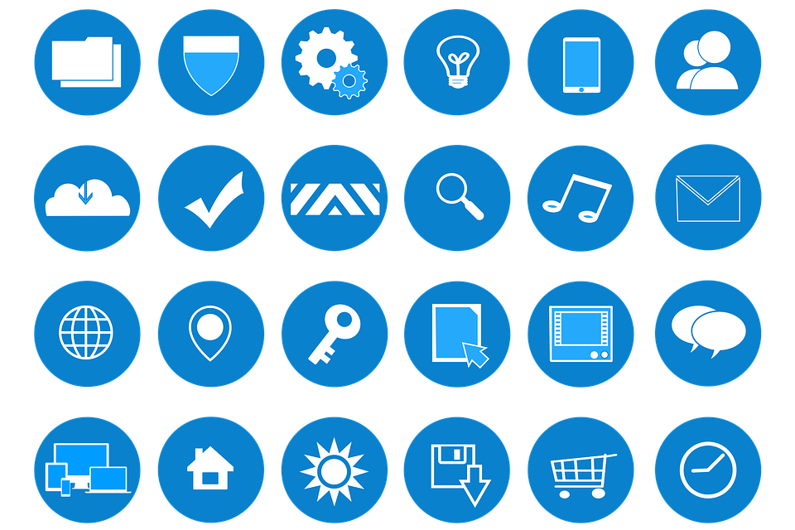
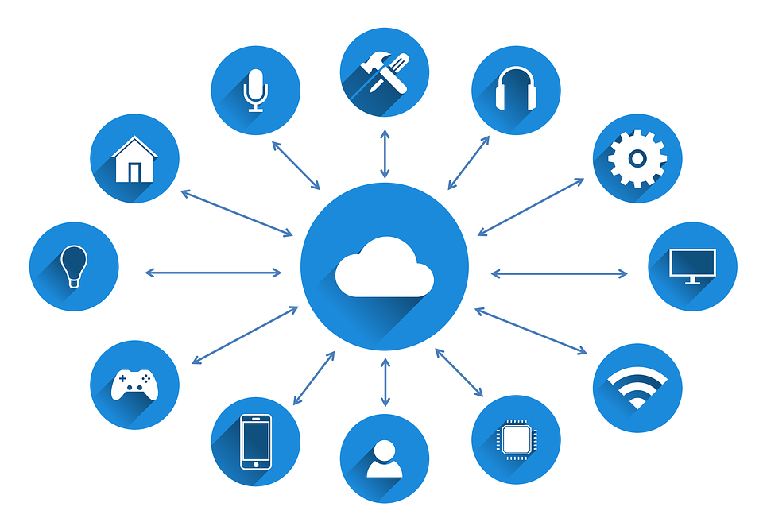
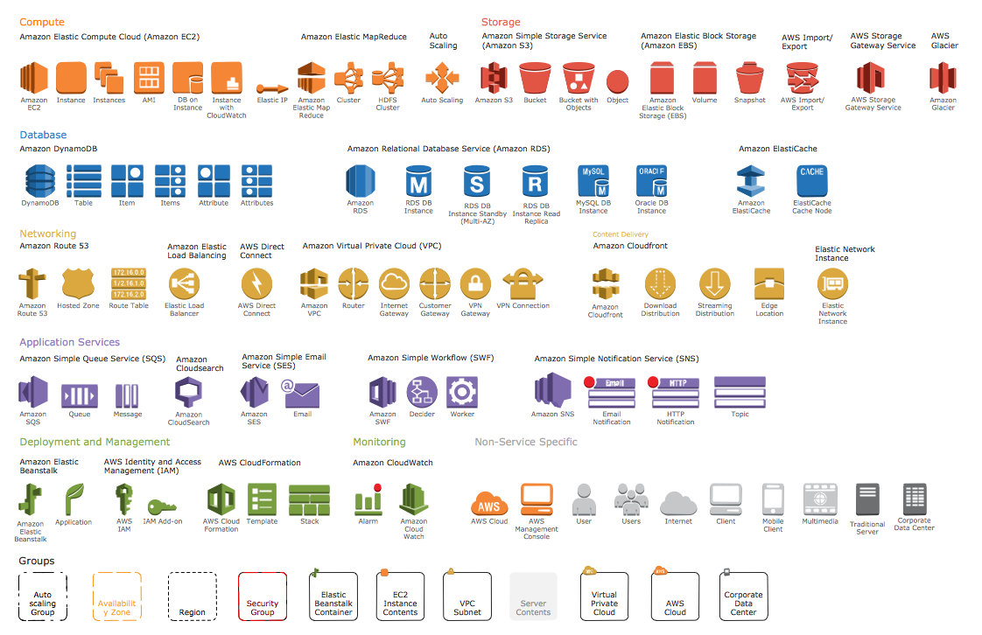
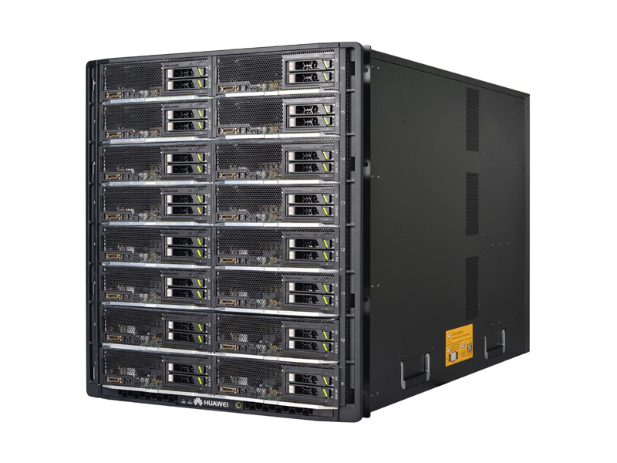



Trend #1: Data gravity triggered the needs for data mobility.
Trend #2: Business logic data (aka lambda functions or computing logic) and traditional business data are roaming in multi-clouds.
The law of data gravity says that applications and data are attracting each other. In today’s IT environment, applications are deployed not only in the enterprise data centers, but also on the public clouds and edges. Therefore, the need for data mobility arises to mitigate the risk of data unavailability for applications.
Various forms of data must co-exist. (Multi-protocol storage arrays like Oceanstor 100D)
Size of data increased dramatically in recent years.
Both business logic (functions) data and regular data need mobility.
More use cases need data mobility (e.g., cloud burst, etc.).
Data migration is more frequent for better performance and lower cost.
Applications
Applications
Applications
Gravity
Gravity
Edge data center
Mobility
Enterprise data center
Mobility
Cloud data center

Slide 4

Data mobility requirements can be hierarchical and bi-directional (e.g., application layer and storage layer).
Multi-cloud Application1
Application layer
Multi-cloud Application2
Catalog/ETL
Data Split/Merge
Data logical layer
Storage @cloud1
Storage @cloud2
Storage @cloud3
Storage layer
Edge data center to data center data mobility
Data center data mobility
Data center to cloud data mobility
Application level data mobility:
Database replication
Vmware replication
Application reads and writes
Application level data mobility:
Vmware replication
Container movement via deployment
Application reads and writes
General S3 backup software
Atempo
Application level data mobility:
Data streaming
Application reads and writes
Storage level data mobility:
File copy / movement
Remote replication
Storage level data mobility:
HyperMetro
HyperReplication
eBackup
eLUN
Storage level data mobility:
eBackup
Storage replication (e.g., Veeam cloud connect)
Consolidate IoT data
First level data processing
Key business data
Long-term cost effective
Abundant computation resources
Agility for provisioning
Application logic and data

Slide 5

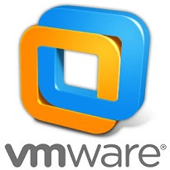




Geo-redundant enterprise data centers
Edge and IoT
Applications
Applications
Database replication
Veeam cloud connect
VM replication
HyperMetro
FusionCube for Edge
HyperReplication
BCmanager eBackup
Dorado / 100D
HyperReplication
Dorado / 100D
Applications
HyperReplication
KubeEdge
Vmware vmotion
Anthos
ATEMPO Miria
HyperReplication
Dorado / 100D
BCmanager eBackup
Edge and IoT
FusionCube for Edge

Slide 6
Huawei End-to-end NVME

Slide 7
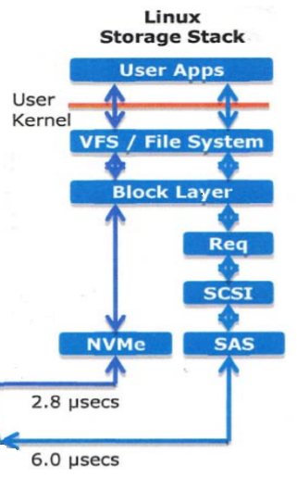
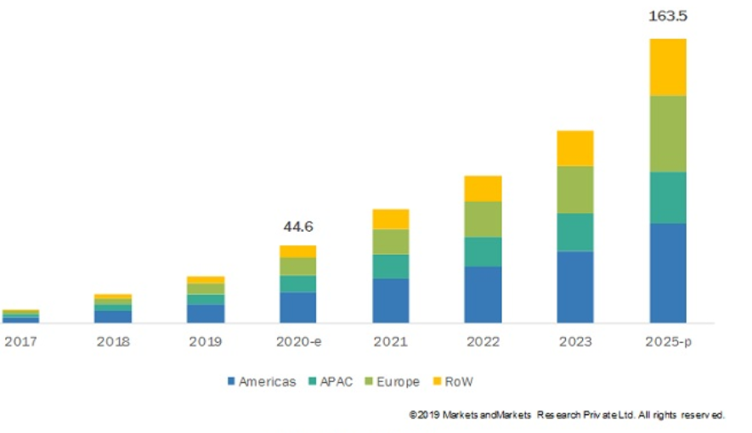
NVME Overview
The global NVMe market size is projected to grow from USD 44.6 billion in 2020 to USD 163.5 billion by 2025; it is expected to grow at a CAGR of 29.7% from 2020 to 2025.
NVMe is an interface that was specifically designed for SSDs, and NVMe SSDs were introduced to provide better data storage and processing operations, and the lowest latency possible when compared with HDDs and traditional SSDs (SATA and SAS).
NVME greatly shortens I/O stack

Slide 8

Huawei End-to-End NVMe over RDMA Fabric
End-to-End NVMe
read
HOST
write
Front-end: NVMe over FC(32G)/NVMe over Fabrics(RoCE).
Back-end: NVMe SSD/Intelligent DAE.
32G/FC 100G/RoCE
Shared Frontend
Shared Frontend
Shared Frontend
Shared Frontend
Self-developed ASIC interface module:
Offload the FCP and NoF protocol stacks
Higher rate 32Gbps(FC)/100Gbps(ETH)
ASIC IO balancing/distribution
50us
30us
Storage Controller
Storage Controller
Storage Controller
Storage Controller
Storage
Engine
Self-developed ASIC SSD disk/enclosure:
The intelligent disk enclosure offloads many internal tasks such as rebuild, greatly improve overall performance.
Multi-queue and polling, lock-free.
Shared Backend
Shared Backend
Shared Backend
Shared Backend
100us
100G/RoCE
Intelligent DAE
Intelligent DAE
Intelligent DAE
Intelligent DAE
ROCE RDMA fabric unifies backend storage network and enables seamless migration to Storage Class Memory (SCM) in the future. Invest today and stay updated with next generation technology.

Slide 9
NVMe Trends
Business Demands
Applications
Bigger data, faster & safer processing
Managing resources & costs effectively
ML
Big Data
Enterprise
Memory-Centric Architecture
Memory APIs
Storage APIs
Memory Fabric
Organizes local/remote memory, SCM and SSDs for data flow
Provides memory and storage APIs for applications
DRAM
NVMe
NVMe over Fabric
RDMA
CCIX
GEN-Z
NVMe-oF
100G/RoCE
End-to-End NVMe over RoCE
Node 1
Node 2
Node 3
Node 4
New Media
DRAM
DRAM
DRAM
DRAM
SCM: Optane DIMM, MRAM
SCM
SCM
SCM
SCM
NVMe SSD
NVMe SSD
NVMe SSD
NVMe SSD
Notes:
From bottom up:
1) media layer: DRAM, SCM, NVMe SSD from all nodes, connected by unified network;
2) protocol layer: NVMe, NVMe over Fabric, RDMA, CCIX;
3) software layer: Memory fabric manages all memory and SSDs, and provide memory APIs and Storage APIs to applications;
4) application layer. Use libraries provided by memory fabric for memory and storage APIs.

Slide 10
Virtualization and Storage

Slide 11
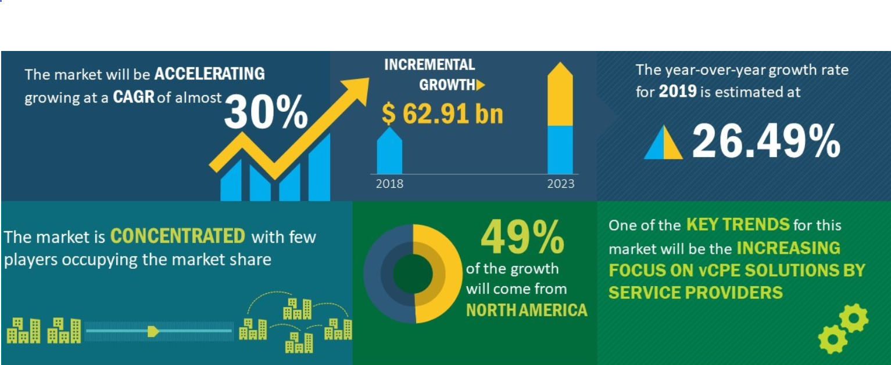
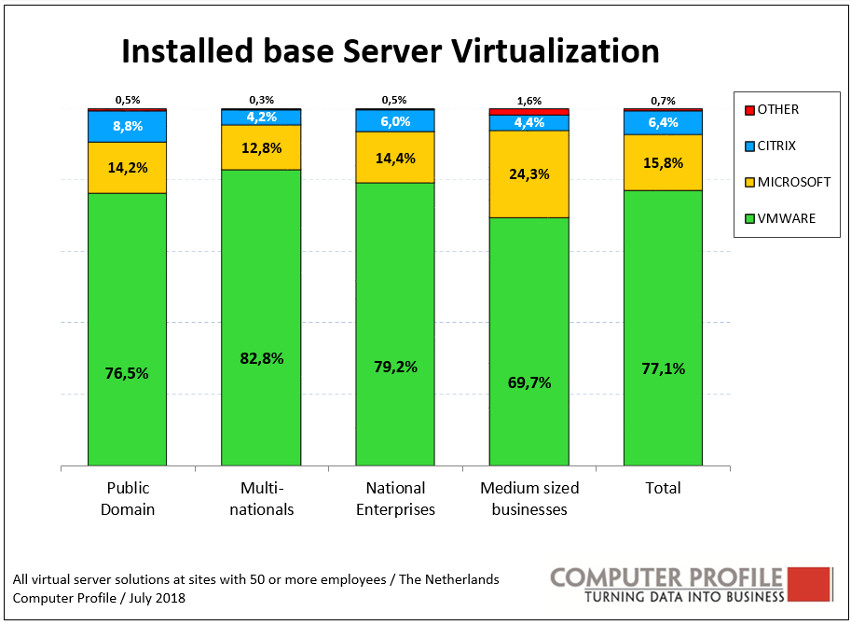
Virtualization Market Trend
VM
Full isolation & functionality
Heavy weight
Container
Good isolation & full OS experience
Light weight
Serverless
(Lamdba)
Extremely light weight
Limited usage
Huawei storage not only has extensive support for today’s major players in the full VM market, but also ready for the container and serverless trend.

Slide 12
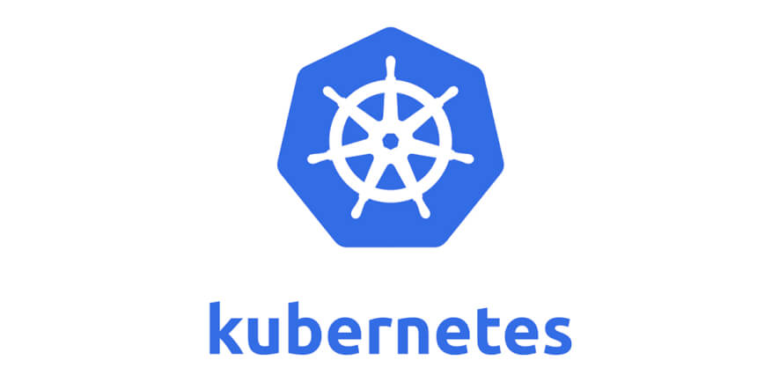



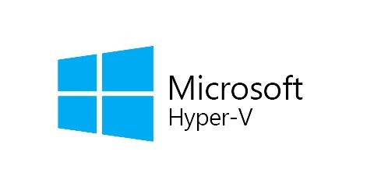

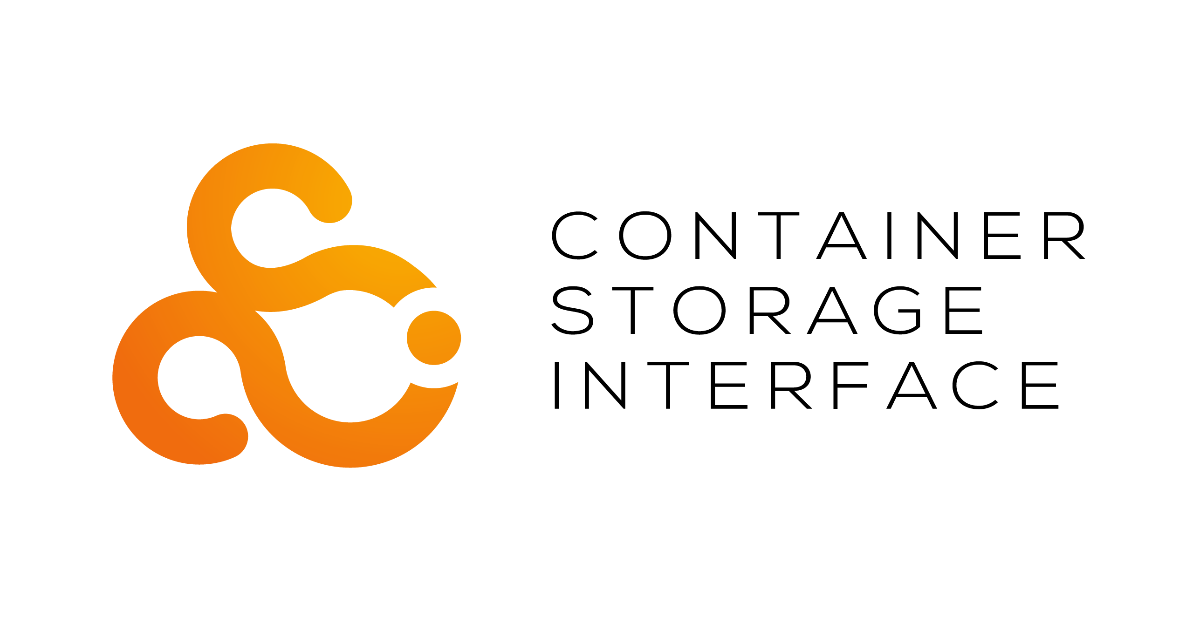

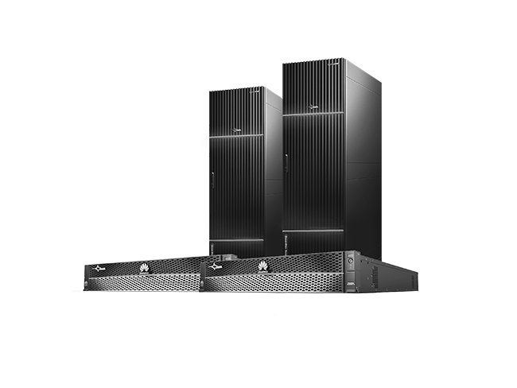
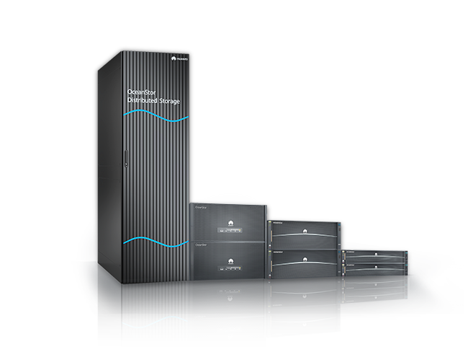
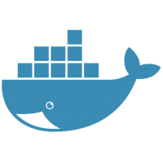
Huawei Storage & Virtualization
Enterprise Applications
Virtualization Layer
Huawei Enterprise Storage
OceanStor Dorado
Enterprise AFA
OceanStor 100D
Distributed Storage
Container Enabled
Notes:
Speaker note:
First emphasize Huawei has always been a key supporter in open source SDS projects, such as open SDS, and our products are compliant to many popular open APIs such as CSI. With these storage APIs, in virtualization context, customer no longer need IBM SVC kind of storage virtualization server, it will save them cost and offer much better performance at the same time.
Next talk about Huawei openstack offerings, including the private cloud product based on openstack (Huawei Cloud Stack), and our all-in-one HCI product FusionCube.
Last talk about our roadmap of containerize storage software stack, as well as providing external-service for running customer containers right on the storage nodes to fully utilize the computing resource.

Slide 13
Unlocking the Value of Data

Slide 14
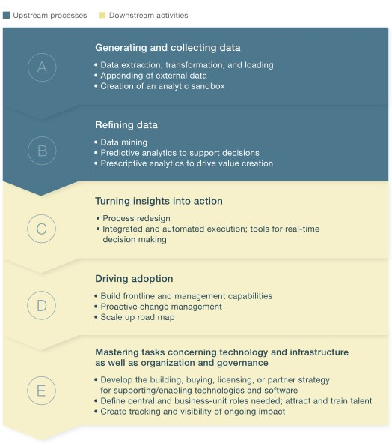
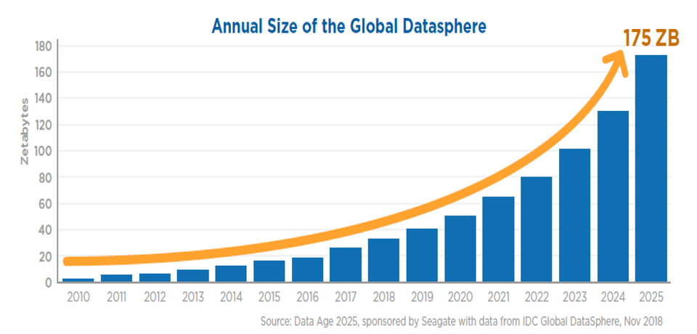
Data Is the New Oil
Turning Data Into Value
The Continued Explosion of Data
Data Use Cases
Top Line (Supporting Growth) | Bottom Line (Reducing Costs) | New Business Models
Cross- and up-sell Churn prevention Pricing Stock and replenishment Promotion Productivity | Predictive maintenance Marketing spend Fraud prevention Bad-debt management Workforce planning Supply chain management | Data as a service Insight as a service Data brokerage Information mediation Data governance Data tools
Source: McKinsey&Company

Slide 15
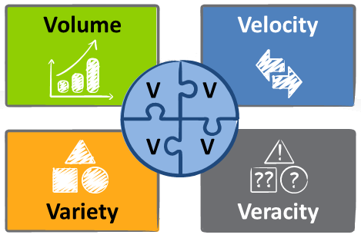
Challenge: Heterogeneous and Siloed Data
80% of companies report a high or moderate degree of data silos (CompTIA)
70% of time spent on data-related projects is spent identifying, cleansing, and integrating data (IBM)
Existing data integration tools fall short of meeting the enterprise needs in a big data era
The Four V’s of big data makes data integration difficult
175 Zettabytes of data will be generated annually by 2025 (IDC)
1.7 MB of data is created for every person on earth every second (DOMO)
Big Data
Unstructured data makes up 80%+ of enterprise data (Datamation)
Only 3% of enterprise data meets basic quality standards (HBR)

Slide 16
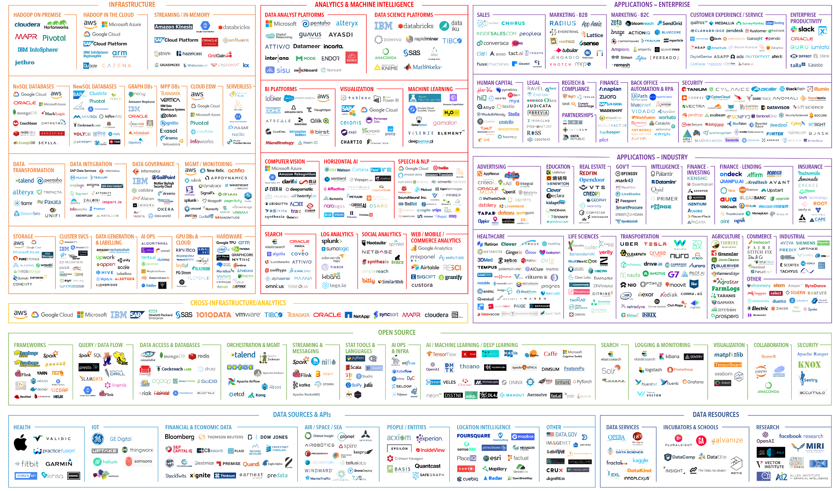
Challenge: Overwhelming Data Tools
The landscape of data tooling is crowded and confusing
Current tools require deep expertise and skills not readily available
Integration of siloed tools incurs large overhead and technical debt
Time-to-value is very long
Source: https://mattturck.com/data2019

Slide 17
Challenge: Disaggregated Data Stores
Internet
Datacenter Network
Datacenter Network
Analytics Cluster
Analytics Cluster
Analytics Cluster
Data Store Cluster
Cluster Network
Cluster Network
Cluster Network
Cluster Network
ToR
ToR
ToR
ToR
ToR
ToR
ToR
ToR
Data access latency and performance variation due to physical distance
Constrained data throughput due to multiple levels of oversubscribed networks
I/O bottleneck due to the limited speed of disks used for very-high-capacity storage
Impeded performance of data-parallel analytics due to the memory wall

Slide 18
Accelerating the Data Value Chain
The Data-to-Value Process
Our Innovations
Virtual Data Lakes
Master data catalog
Data virtualization engine
Data privacy protection
Low-Code Application Development
Visual programming
Model-driven development
Data and model governance
Optimization of Data Infrastructure
Near-data processing
Semantic caching
Holistic optimization

Slide 19
AI and Storage

Slide 20
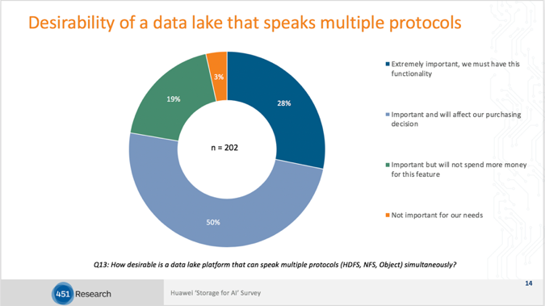
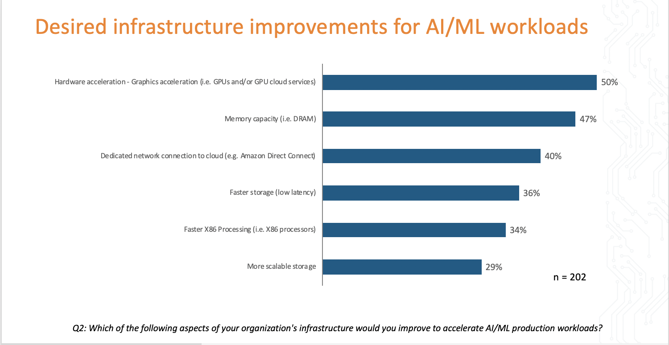
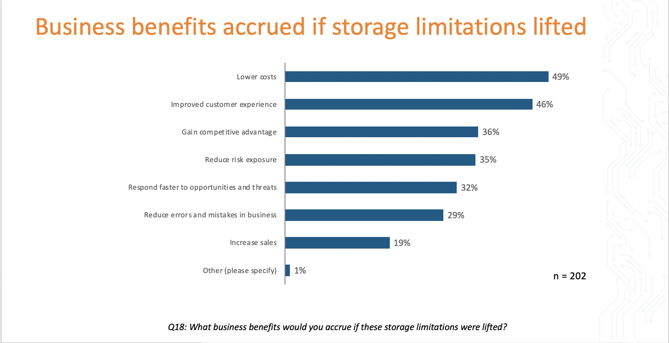
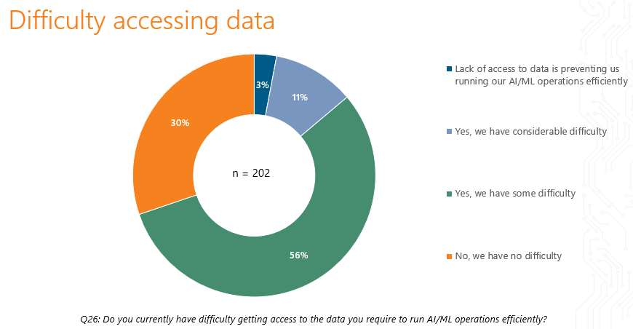
451 Report - Storage for AI
What can storage do to improve customer AI investment return rate?

Slide 21








AI storage support Data Life Cycle Pipeline
Ingest
Preparation
Training
Inference
Cloud
Training
GPU Cluster
IM1
IM2
IM3
...
3
Data Lake
Training (training)
Sets
1
Training (training)
Sets
4
Training
Data Sets
2
Key requirement:
OceanStor 100D
Dorado V6
1
Multi-protocol Access
Data set load from in-line by NFS/SMB; analysis data from big data by HDFS; Internet/Web data by S3 object.
3
Ultra High performance low latency
GPU/TPU more efficiency demands high storage bandwidth with low latency. All-flash or Burst Buffer must be provided to accelerate performance.
2
Training & inference share dataset
Not need data copy or moving in different data process, support elastic extend up to 10 Billion files, hot data and cold data tier. Huge dataset demands storage efficiency with EC instead of copies(HDFS standard 3 copies)
4
Data mobility with DC and public clouds
provide cloud archive services. Supports data moving cross the cloud, or uses GPU/TPU resources on the cloud for bursting training.

Slide 22
451 Report - AI for Storage
Top areas for AI enhanced tools
36% are willing to pay for AI/ML enhancements for support
Efficiency and capacity planning highlight the value of AI enhanced tools

Slide 23



Huawei Self-Driving IT (“AI For Storage”)
Trusted Third-Party Cloud
Offline eService
Federated cloud
AI-Driven Operation
Smart Datacenter & Hybrid Cloud and Data Mobility Solution
AI-Driven Intelligent Storage
Other Clouds
Huawei Cloud
Performance Auto-tuning
Anomaly Detection
Auto Configuration and Deployment
Intelligent Performance Tuning
Intelligent Cache
Intelligent Dedup/comp
Intelligent Tiering
Intelligent QoS
Intelligent Perf Tuning
Intelligent Troubleshooting
DR-readiness assessment
SSD Failure Prediction
HDD Failure Prediction
Intelligent RCA/Self-Healing
Proactive Health Score
Anomaly Detection
Intelligent Configuration Automation
Intelligent App-aware Provisioning
Intelligent Res Planning
Huawei AI chips/GUPs
Huawei Real Time Global Telemetry Network
eService BDL AI Platform
DC Anomality Detection
Intelligent logging analysis using ELK (ElasticSearch, Logstash, and Kibana)
Third-party AIOps software (Splunk，BMC, Moogsoft…) integration
DC Service Automation
Integrating with ITOM Service Ticket systems （ServiceNow…)
Corp support/service data
DC Intelligent
Deployment & Orchestration
Intelligent Hybrid Cloud (w/ Serverless Event-Driven Automation & Orchestration)
VM/Container Performance
Intelligent O&M
Intelligent Cooling
Intelligent Idle System reporting and optimization recommendations
More 。。。
AI chips
Cloud ML/DL/Big Data SW Tools
Cloud HW/SW Security
Huawei Cloud Smart Datacenter
AI-Driven Intelligent Compute
Huawei AI-Driven Smart Network
Intelligent Automation
Intelligent cooling
Intelligent power
Intelligent Troubleshooting
SSD Failure Prediction
HDD Failure Prediction
Intelligent RCA/Self-Healing
Proactive Health Score
Anomaly Detection
AI-driven Smart IoT Support (Future)

Slide 24
GDPR Market

Slide 25
Important Facts
The rise of regulations:
GDPR, CCPA, DPB, LGPD, etc.
By 2023, 65% of the world's population will have its personal information covered under regulations, up from 10% today
The General Data Protection Regulation (GDPR) is a law which establishes a single set of rules for every EU Member State to
protect personal data.
Effective data: 25 May 2018
One year later: only one in three organizations are fully compliant with GDPR
GDPR fines in the first 20 months: FaceBook, Google, whatsApp, and hundreds more
Company's Responsibilities
Privacy will become a business differentiator.
A proactive approach to data protection helps organizations increase trust.
Data
Governance
Risk Assessment
Compliance
Management
Breach
Response
GDPR compliance model
Gartner: Over 40% of privacy compliance technology will rely on AI by 2023, up from 5% today.
Level 1
Basic GDPR compliance
Level 2
End-to-end GDPR compliance
Level 3
Policy-based GDPR compliance
Level 4
AI-assisted GDPR compliance
Notes:
Data governance: Know where data is in the enterprise and who has access and implement controls in data processing activities.
Risk assessment: Establish a risk assessment process to ensure controls are appropriately designed and implemented.
Compliance management: Establish a compliance program to ensure controls are effective and operational.
Breach response: Detect and respond to the threat before a breach occurs but if a breach does occur, you need to know the details and exact impact.

Slide 26
GDPR Solution in a Banking System Data Center Environment
Available today)
To be enhanced
To Be Developed
3rd party
Reporting and Impact Analysis
Reporting and Impact Analysis
Enterprise GDPR
Framework
Core Bank Business Transaction System
Enterprise GDPR
Lifecycle
Production Data
Core Database
Core Unstructured Data
Secondary Data
DR Data
Backup Archiving
Online Transaction System
Batch Transaction System
Customer CIF
Accounting System
Data Warehouse
Big Data Platform
Video Surveillance
Test & Dev
VDI
Assessment
Data
Governance
Storage GDPR Framework
Compliance
Management
Metadata & data governance
Access control
Encryption
Governance & Design
Monitoring, Auditing & Reporting
Metadata Indexing
For query
Auditing Report
Event Notification
Geo-aware replication
WORM
RBAC
Customer Key Encryption
Data Usage Report
Virus Checker
FileAutoPolicy
Timely deletion
File
Data states (readiness)
Auditing
KMIP
Data in Flight Encryption
Risk
Assessment
Log Collection & Filtering
Delete & Un-map
Allow Write/Update
Transform & Deploy
Data geo location
Anomaly Detection
MFA
Check Permission
SED
Processing Report
Secure Erasure
Lineage
Pseudonymization
Operate & Monitor
Breach
Response
Data Integrity
HA
Storage Platforms
Block
File
Object
HDFS
Public Cloud Data Services
Data Replication
Snapshot
Archiving & Backup
OceanStor Dorado
OceanStor 100D
AWS
Azure
Huawei

